Slide 1

Electrolysis and Material Storage of Hydrogen Gas
Notes:
Hannah
Welcome and thank you for coming to embry-riddle hydrogens design concept review. Our project focuses on hydrogen technology, specifically electrolysis and material storage of hydrogen

Slide 2







Team Members
Hannah Spiller
Design Team Lead
Dylan Astrup
Grant Carrabine
Tesla Alford III
Titan Berson
Jacob Wolf
Notes:
Hannah and kinda us
My name is Hannah Spiller, I am the design team lead, and this is my team.

Slide 3







Agenda
Introduction
Problem
Solution
Evidence
Budget
Timeline
Conclusion
Notes:
;SHannah
The agenda of today’s presentation will be… Introductions, introducing the problem, our proposed solution, providing all of our evidence, going over the budget, explaining the timeline, and finally conclusions

Slide 4
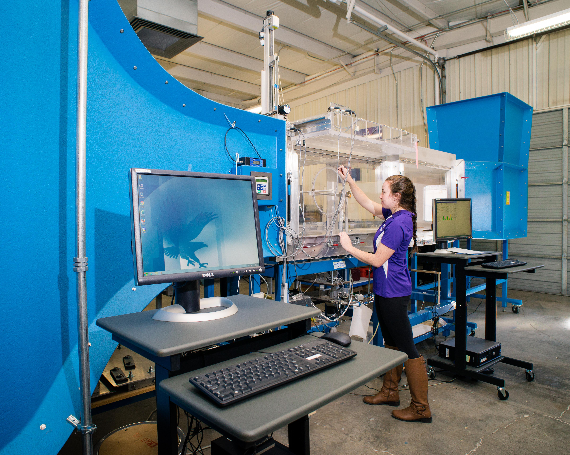
Embry-Riddle has a Wind Tunnel
2:00
Notes:
Jacob
Nancy and tracy doryland wind tunnel

Slide 5
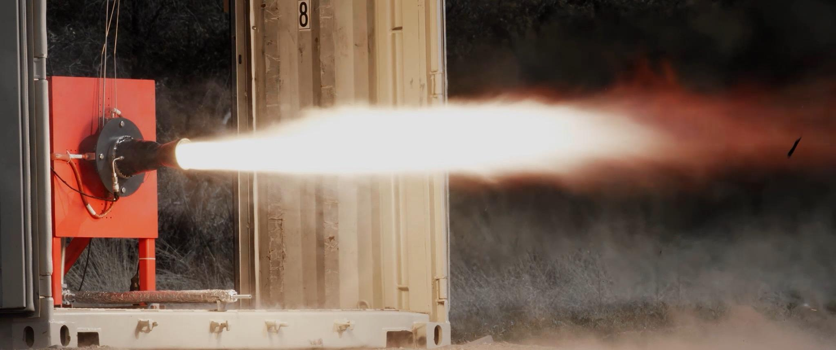
Embry-Riddle has a Propulsion Lab
2:00
Notes:
Jacob
Test cell three and the propulsion and fabrication test facility

Slide 6
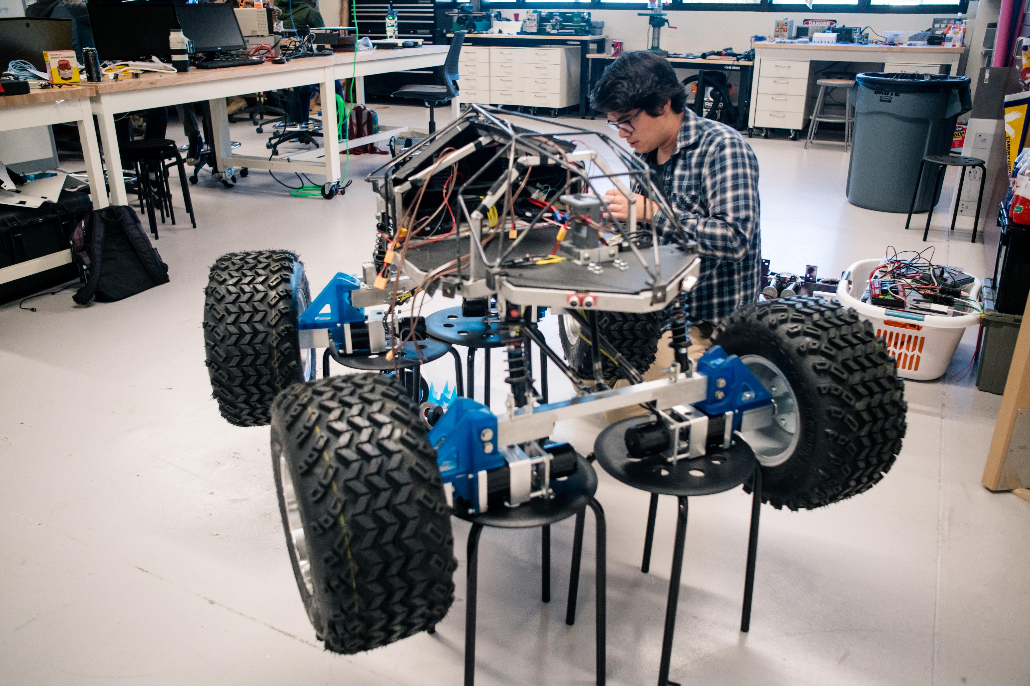
Embry-Riddle has a Robotics Lab
2:00
Notes:
Jacob
Space robotics lab

Slide 7
Embry-Riddle does not have
Energy Labs
Energy Classrooms
Viewable Demonstrations
3:00
Notes:
Jacob

Slide 8
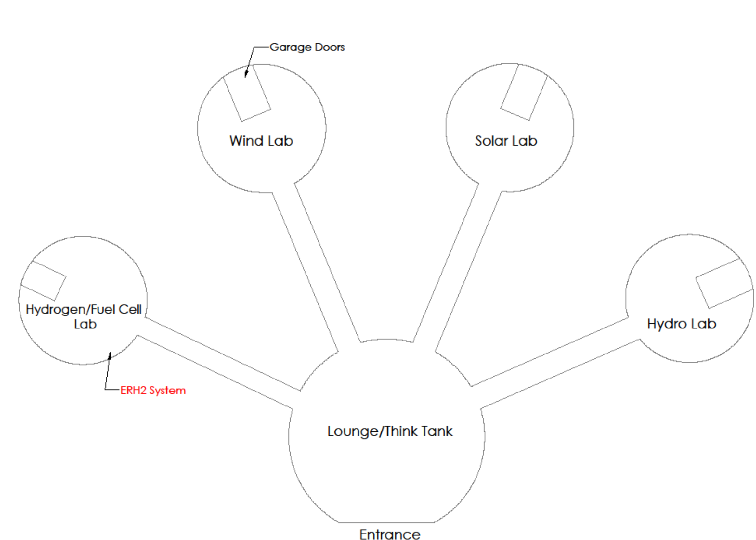
Energy Research and Interactive Experimentation (EyRIE) Lab
4:00
Notes:
Tesla

Slide 9
DOE Research into Hydrogen
The DOE is researching multiple uses for hydrogen gas, producing the need for more hydrogen. This creates interest within Embry-Riddle to create an EyRIE Lab demonstrator that teaches the general public about hydrogen fuel and storage.
5:00
Notes:
Tesla

Slide 10
Generate and Store Hydrogen
ERH2’s purpose is to create a demonstrator to generate and store hydrogen at ambient conditions.
6:00
Notes:
Dylan

Slide 11
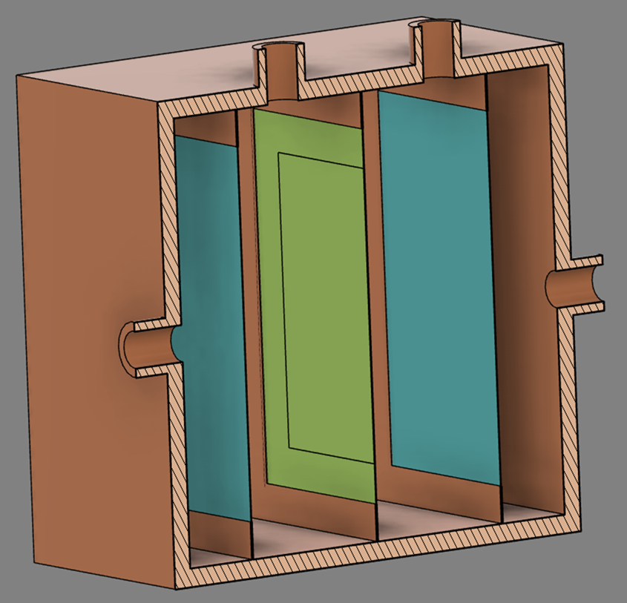
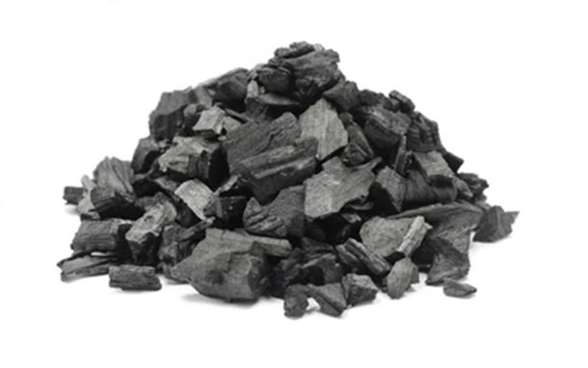
Electrolyzer & Storage
Electrolysis
Material Storage
7:00
ERH2’s Electrolyzer
Graphitic Carbon Nitride
Notes:
Grant
Our system will produce and store of hydrogen to demonstrate how hydrogen can be used as an alternative to traditional fuels to generate electricity. This will be done by producing hydrogen to be stored in material-based storage to run the schools fuel cell for 10 minutes at 1 watt.
Basics of how our system will process from electrolysis to material storage then to the fuel cell

Slide 12
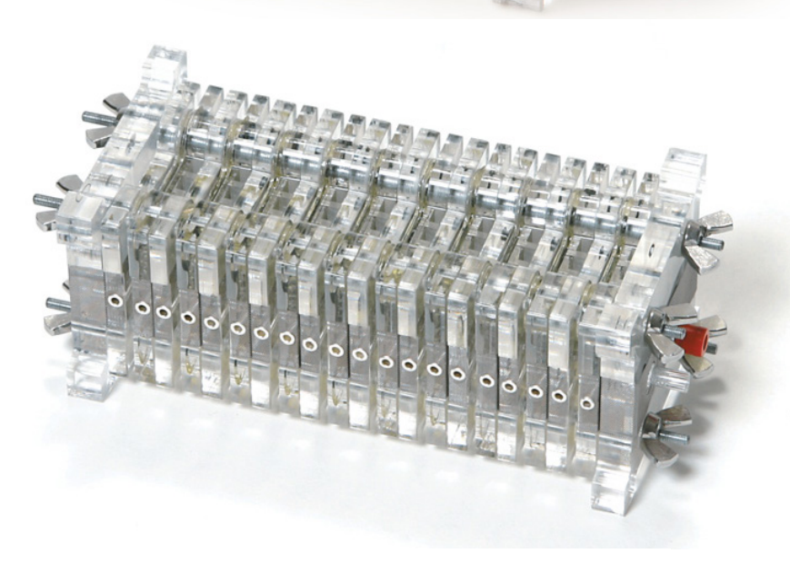
Fuel Cell
The fuel cell provided by the energy department
7:00
Notes:
Grant
Our system will produce and store of hydrogen to demonstrate how hydrogen can be used as an alternative to traditional fuels to generate electricity. This will be done by producing hydrogen to be stored in material-based storage to run the schools fuel cell for 10 minutes at 1 watt.
This is an image of the fuel cell we will be using provided by the energy department we will be using to produce hydrogen from our material strage

Slide 13
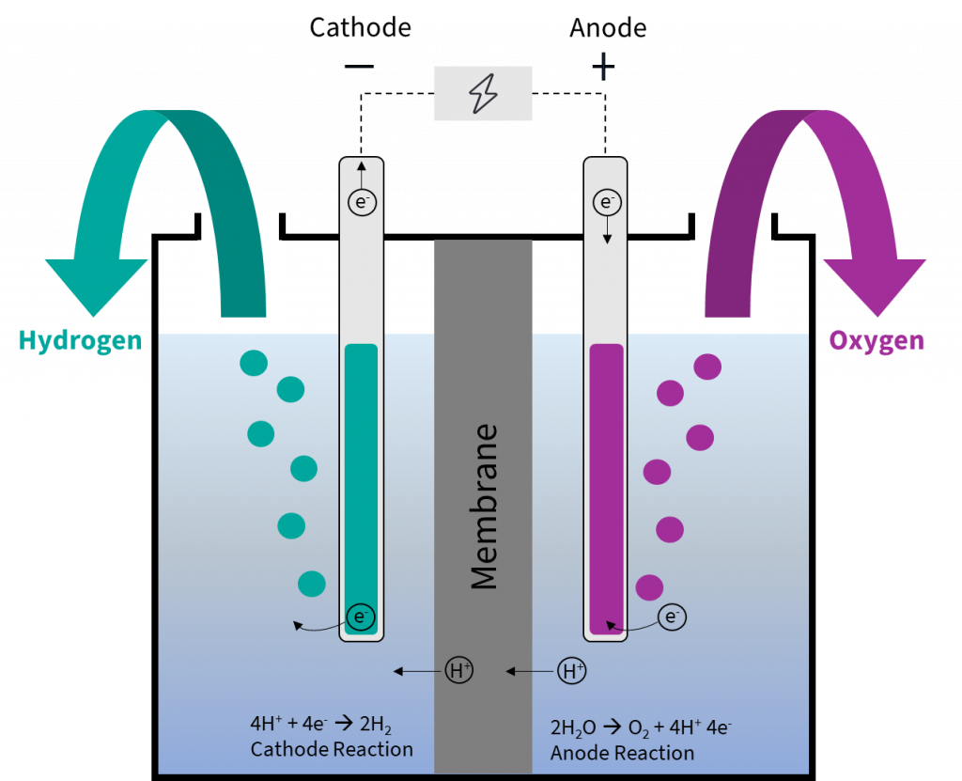
How the Electrolyzer Works
https://ptx-hub.org/water-electrolysis-explained/
7:00
Notes:
Grant
process by which electric current is passed through a substance to effect a chemical change

Slide 14
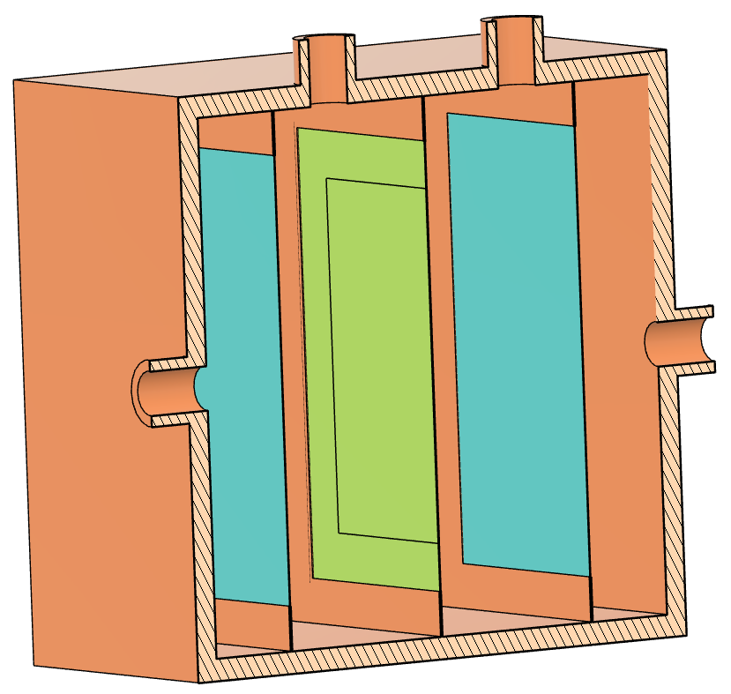
Electrolyzer Breakdown
Hydrogen
Oxygen
Plexiglass
Water
Water
Nickel Mesh
Membrane
Model of ERH2’s planned Electrolyzer
8:00
Notes:
Grant
3.1.1 The internal system components should be visible for educational purposes.
1.1 The system must produce hydrogen gas.
1.1.1 The system must produce 0.02 grams of hydrogen gas to run the fuel cell for 10 minutes at 1 watt.
4.2.1 The system must be movable.
Explane the photo pem cell use about .2 grams of water every 10 minutes

Slide 15

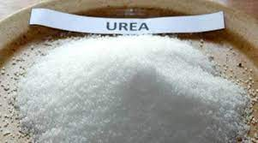
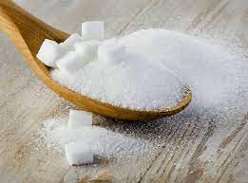
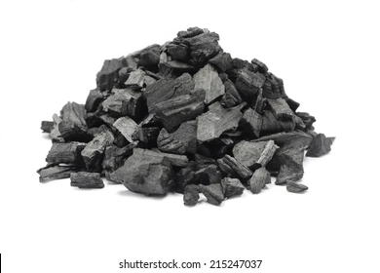

Storing Hydrogen
Sugar
$$H_{2}$$
Graphitic Carbon Nitride
9:00
Notes:
Titan

Slide 16



Releasing Hydrogen
Material Storage:
$$H_{2}$$
+300°C
10:00
Notes:
Titan

Slide 17
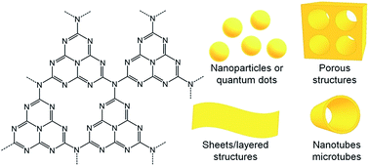
Graphitic Carbon Nitride
Molecular Level
Naked Eye
11:00
Notes:
Titan

Slide 18
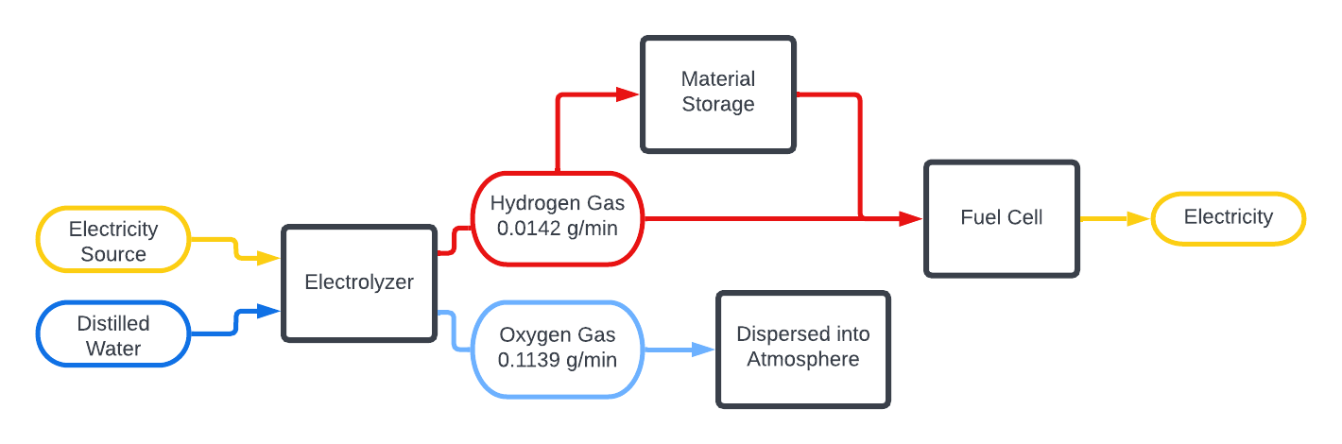
System Layout
Simplified PFD
11:00
Notes:
Jacob

Slide 19
Critical Generation Requirements
Notes:
Dylan

Slide 20
Satisfying Housing Requirements
4.2.1
“Electrolyzer must be movable.”
3.1.1
“The internal system components should be visible for educational purposes.”
Unit will be approx. 4in x 6in x 6in (LxWxH)
13:00
Notes:
Dylan

Slide 21


Satisfying Safety Requirements
2.1
“The system must allow for safe extraction of hydrogen gas without risk of major leaks.”
2.2
“The system must follow Embry-Riddle Prescott Campus’ safety requirements.”
14:00
Notes:
Dylan
Produces 0.142 grams of H2 in a secure, airtight casing with proper seals.
The electrolyzer follows the ER-PC safety guide
We have also been

Slide 22

Satisfying Education Requirements
3.1.2.1
“The system must display the approximate amount of hydrogen gas being produced.”
Example of a gas flowmeter
14:00
Notes:
Hannah

Slide 23

Satisfying Generation Requirements
1.1.1
“The system must produce 0.02 grams of hydrogen gas to run the fuel cell for 10 minutes.”
15:00
Notes:
Hannah
4.3 The electrolyzer will produce 0.142 grams of H2 exceeding the 0.02 grams required

Slide 24
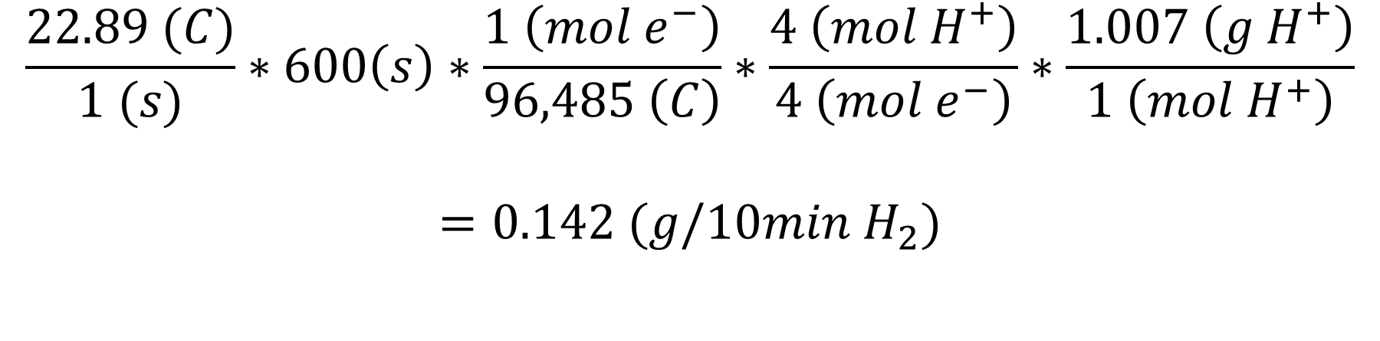
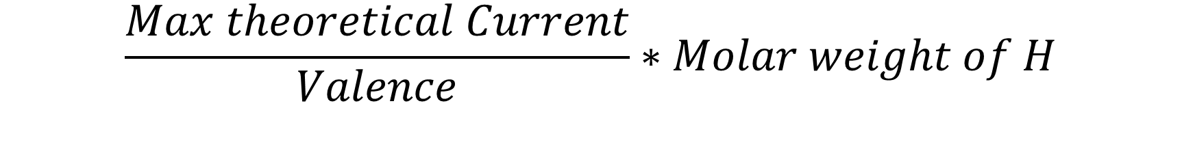
Rate of H2 Production
Faraday’s Law of Electrolysis
$$\frac{Max theoretical Current}{Valence}∗Molar weight of H$$
$$\frac{22.89 (C)}{1 (s)}∗600\left(s\right)∗\frac{1 \left(mol e^{−}\right)}{96,485 \left(C\right)}∗\frac{4 \left(mol H^{+}\right)}{4 \left(mol e^{−}\right)}∗\frac{1.007 \left(g H^{+}\right)}{1 \left(mol H^{+}\right)}$$
$$=0.142 (g/10min{ H}_{2})$$
16:00
Notes:
Hannah

Slide 25
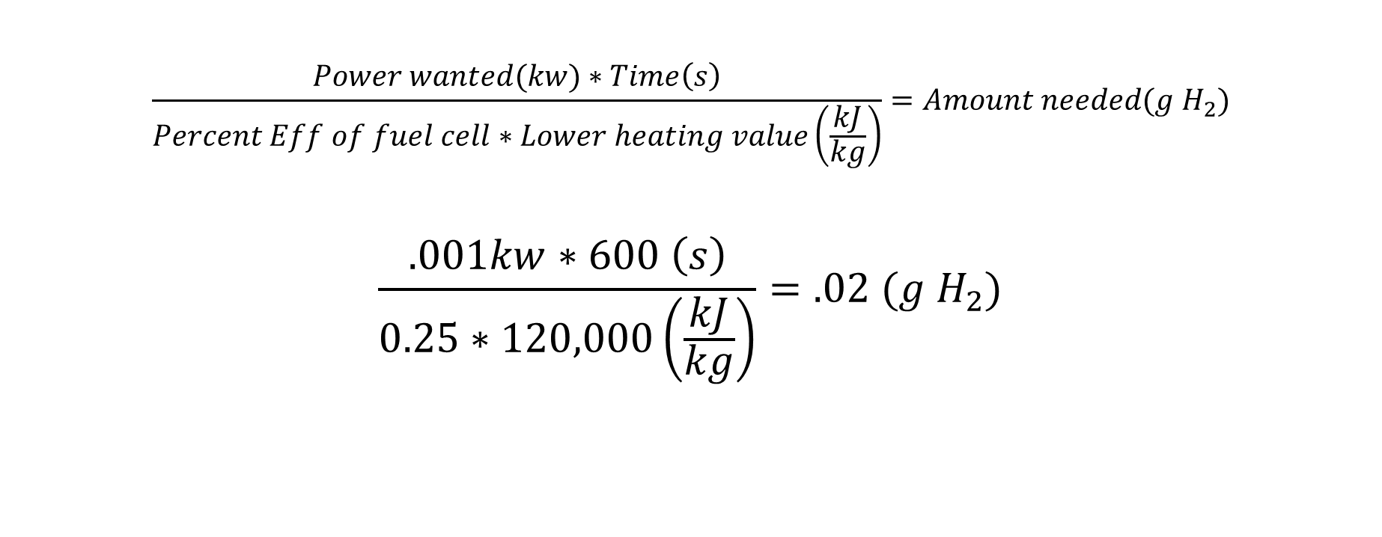
Fuel Cell Requirements
$$\frac{Power wanted(kw)∗Time\left(s\right)}{Percent Eff of fuel cell∗Lower heating value\left(\frac{kJ}{kg}\right)}=Amount needed(g H_{2})$$
$$\frac{.001kw∗600 \left(s\right)}{0.25∗120,000\left(\frac{kJ}{kg}\right)}=.02 (g H_{2})$$
17:00
Notes:
Grant
Calcs on what is need to run the fuel cell at 1 w for 10 minutes

Slide 26
Generation - Decision Matrix
GENERATION | Weighting | SMR (Datum) | Biological | Electrolysis
Cost | 1 | - | -1 | 1
Production rate | 2 | - | -1 | -1
System efficiency | 3 | - | -1 | 1
Total |  | - | -5 | 2
19:00
Notes:
Titan

Slide 27
Critical Storage Requirements
Notes:
Titan

Slide 28
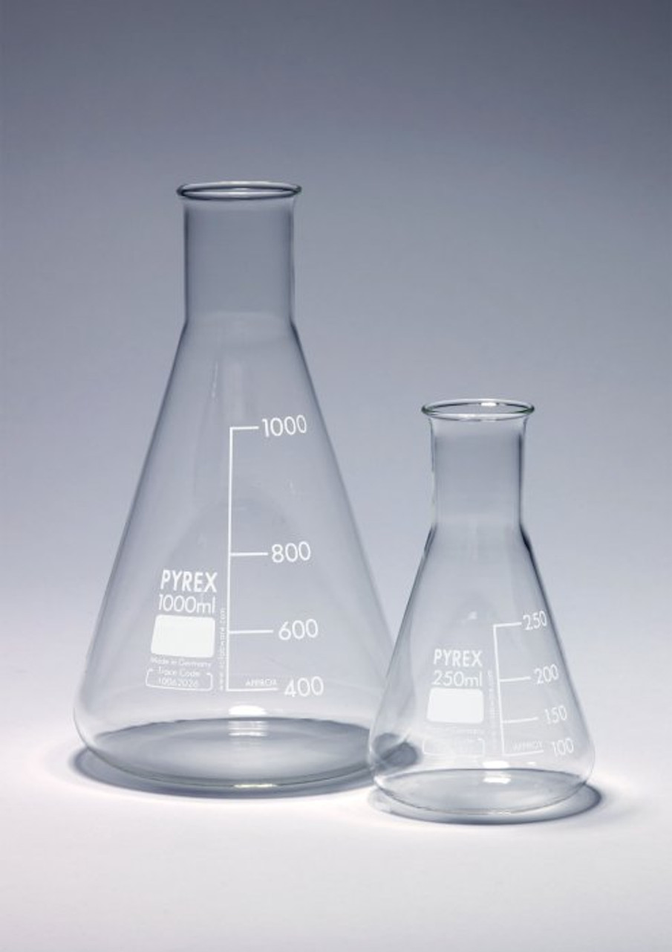

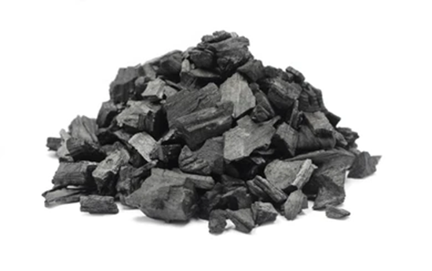
Satisfying Storage Requirements
1.2
“The system must store 0.04 grams of hydrogen gas.”
20:00
Notes:
Tesla

Slide 29


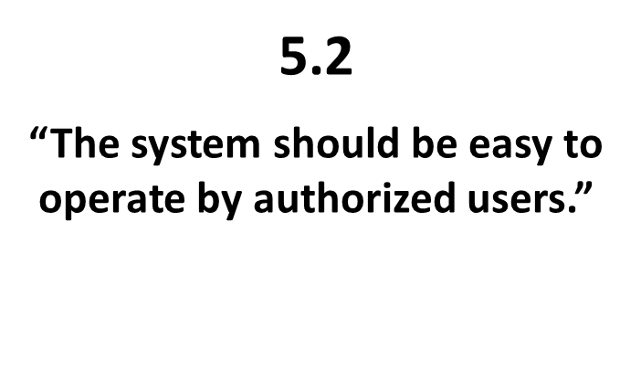
Satisfying Storage Requirements
2.1
“The system must allow for safe extraction of hydrogen gas without risk of major leaks.”
21:00
Notes:
Tesla

Slide 30
Storage Methods
Storing Hydrogen
Physical Based
Material Based
22:00
Notes:
Tesla

Slide 31
Carbon Nitride is Best for Storage
STORAGE | Weighting | Physical (Datum) | Metal Hydride | Intermetallic Hydride | Chemical Hydride | Carbon Nitride
Cost | 2 | - | 1 | 1 | 1 | 1
Capacity | 3 | - | -1 | -1 | -1 | 1
Discharge rate | 1 | - | -1 | 1 | 1 | -1
Total |  | - | -2 | 0 | 0 | 4
24:00
Notes:
Titan

Slide 32
Budget
INCOME
 | Base | $1,300.00
 | TOTAL INCOME | $1,300.00
EXPENSES
 | Electrolysis | $675.00
 | Material Storage | $230.00
 | Charge/Discharge | $87.00
 | Plumbing | $24.00
 | Instrumentation | $400.00
 | Valves | $80.00
 | Sealant | $30.00
 | Electrical | $30.00
 | Team Shirts | $80.00
 | TOTAL EXPENSES | $1,636.00
TOTAL |  | $(336.00)
26:00
Notes:
Hannah
Expenses are overestimates

Slide 33
Schedule
Task | Start Date | End Date
Build Electrolysis | 2/13/2023 | 3/3/2023
Assemble Plumbing | 3/6/2023 | 3/20/2023
Valves and Seals | 3/20/2023 | 3/31/2023
Final Report | 2/15/2023 | 4/28/2023
27:00
Notes:
Hannah

Slide 34
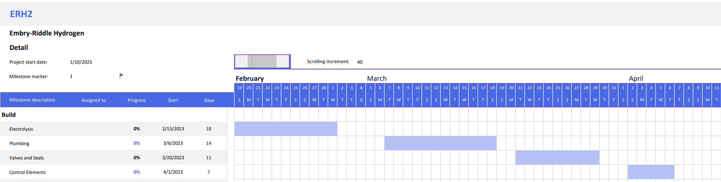
Schedule
28:00
Notes:
Hannah

Slide 35
Acknowledgements
Dr. Karl Heine
Dr. Johnathan Adams
Dr. Richard DiPietro
Dr. Hillary Eaton
Professor Rachel Schmidt
Dr. Istemi Ozsoy
Dr. David Lanning
Dr. Robert Murray-Smith
AXFAB Staff
Mansidak Singh
30:00
Notes:
Hannah

Slide 36

Questions?

Slide 37
Additional Slides
Requirements
Generation
Natural Gas
Photobiological
Microbial Biomass conversion
Storage
Physical
Material
Equations
Graphic Design
Schedule

Slide 38

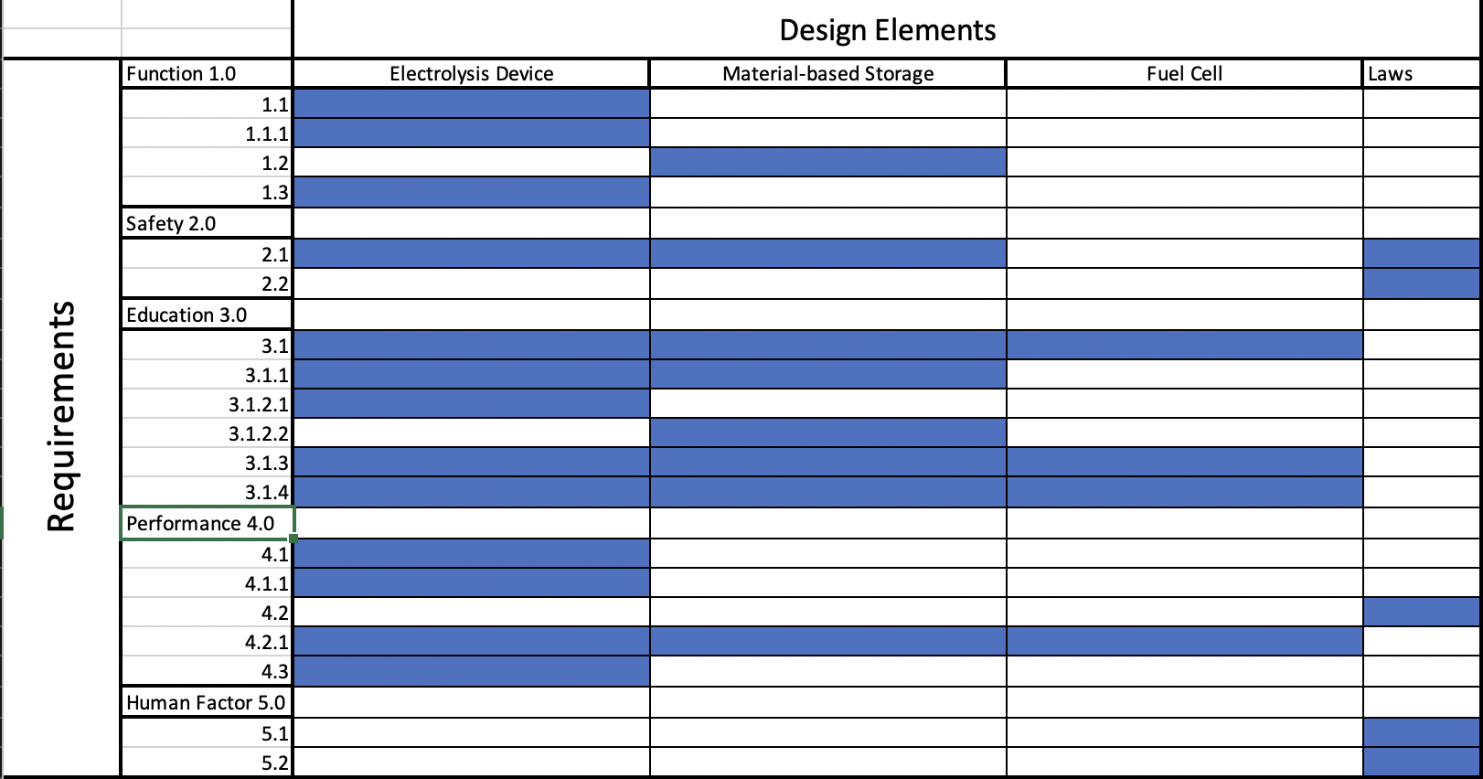
Requirements Matrix

Slide 39
Generation - Natural Gas
Methane Resource
Methane is collected from a source (usually from natural gas)
Steam-Methane Reforming
High temperature steam (at 700-1,000 °C) is added to the methane gas
Hydrogen Extraction
Hydrogen gas is extracted from the steam-methane mix from an added catalyst
Notes:
The common catalyst used for steam-methane is typically nickel but research has been done showing that the noble metals can also work. This process produces hydrogen gas, carbon monoxide, and a small amount of carbon dioxide. DOE did not specify how much CO2 was produced.

Slide 40
Generation - Photobiological
Bacteria Strain
Water is Supplied
Bacteria Uses Photosynthesis
Water is Broken Down into its Elemental Form
Hydrogen Gas is Released
Notes:
After a complete cycle, the bacteria will need some amount of filtration provided, before adding more water. This filtration will remove all nitrates and acidic biproduct chemicals that was produced during a full cycle. During this process the bacteria will consume a percentage of the hydrogen gas, making the gas production rates and net efficiency of the system low.

Slide 41
Generation - Microbial Biomass Conversion
Bacteria Strain
Hydrocarbon is Added
Bacteria Uses Fermentation
After Fermentation, the Bacteria Leaves Behind Several Elements
Hydrogen Gas can be Filtered Out.

Slide 42
Storage – Physical Storage
Compressed
5,000-10,000 PSI
Unique Pressure Vessels
Cryogenic
Liquid H2 at -252.2 °C
Solid H2 at -259.14°C

Slide 43
Storage – Material Storage
Adsorbtion
Hydrogen is Stuck to the Compound’s Surface
Absorption
Hydrogen is Encased by the Compound

Slide 44
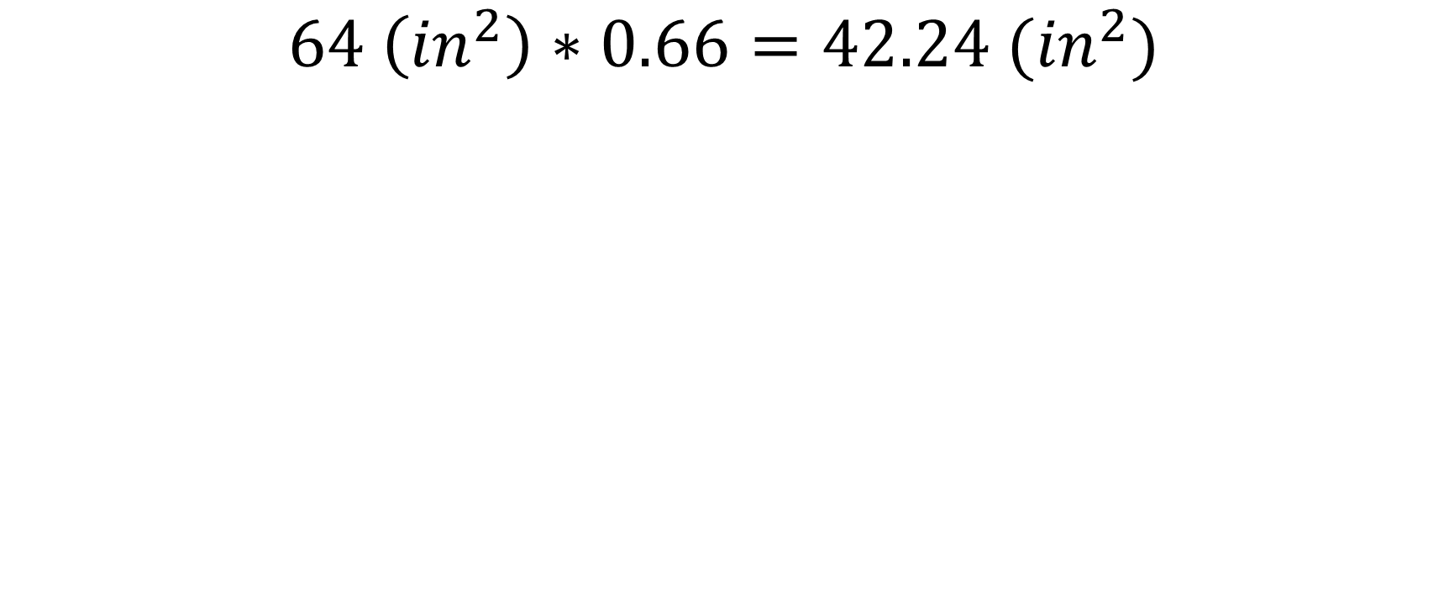
Equations – Area of Mesh
$$64 \left({in}^{2}\right)∗0.66=42.24 ({in}^{2})$$

Slide 45
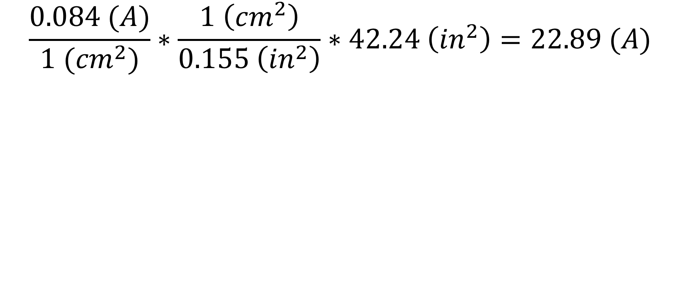
Equations – Max Current
$$\frac{0.084 (A)}{1 ({cm}^{2})}∗\frac{1 \left({cm}^{2}\right)}{0.155 \left({in}^{2}\right)}∗42.24 \left({in}^{2}\right)=22.89 (A)$$

Slide 46
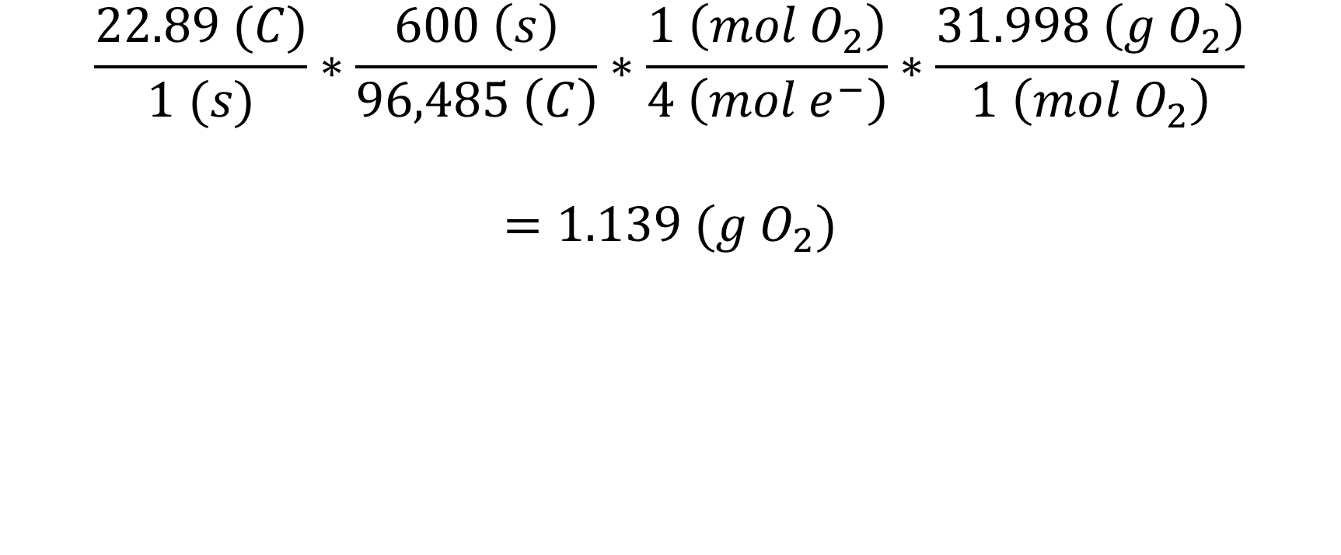
Equations – Rate of O2 Production
$$\frac{22.89 (C)}{1 (s)}∗\frac{600 \left(s\right)}{96,485 \left(C\right)}∗\frac{1 \left(mol O_{2}\right)}{4 \left(mol e^{−}\right)}∗\frac{31.998 \left(g O_{2}\right)}{1 \left(mol O_{2}\right)}$$
$$=1.139 (g O_{2})$$

Slide 47

Schedule of Project
Date tracking Gantt ERH2 (version 1).xlsb.xlsx

Slide 48


